Slide 1
On the advances of the ITU rec. on QoE Assessment of eXtended Reality Meetings (P.QXM)
This draft Recommendation advises on aspects of importance for QoE assessment of telemeetings with extended reality elements. The goal is to define the system, human, and context factors that affect the choice of the QoE assessment procedure and metrics when extended reality telemeeting systems are under evaluation.
This Recommendation defines the following terms:
3.2.1 XR telemeeting
The XR telemeeting should aim to immerse the participants, for example by spatial reproduction of audio and video, and to enhance the exchange of information with augmented elements, for example by using virtual avatars or virtual objects. Telemeeting taking place in a virtual location or a combination of virtual and real locations; telemeeting with mixtures of real and virtual participants; telemeeting with augmented elements for collaboration; virtual conferences; (joint) teleoperation of equipment.
Ericsson Research, DRI
2022-05-10

Slide 2
ITU-T Study Group 12
Responsible for recommendations on performance, quality of service (QoS) and quality of experience (QoE)
Gunilla Berndtsson is vice chairman for WP1 “Terminals and multimedia subjective assessment”
Co-rapporteur for ITU-T SG12/Q10 “Conferencing and telemeeting assessment”
Current work on Q10 recommendations:
P.QXM “QoE Assessment of eXtended Reality (XR) Meetings”
G.TeleMeTax ”Taxonomy of telemeeting systems from a QoE/QoS perspective” characterizing all types of telemeetings including XR meetings.
The article "Quality of Experience in Telemeetings and Videoconferencing: A Comprehensive Survey.pdf" has been accepted for publication in IEEE Access.

Slide 3
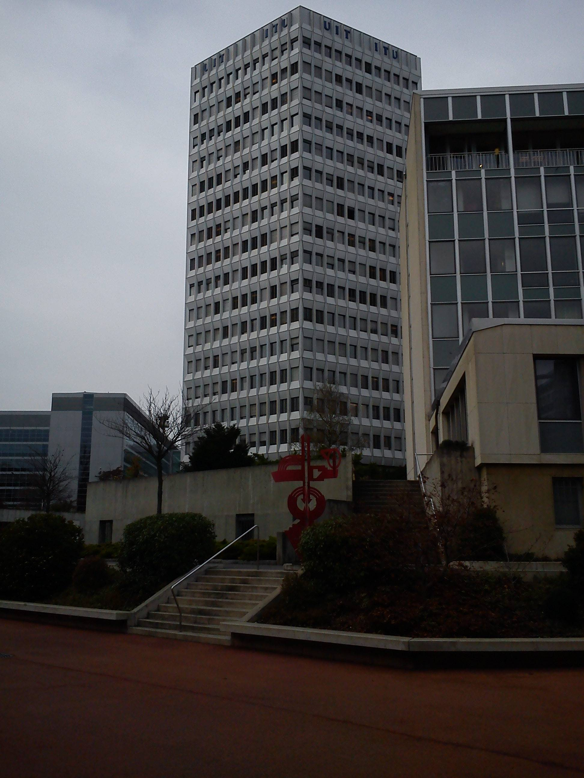
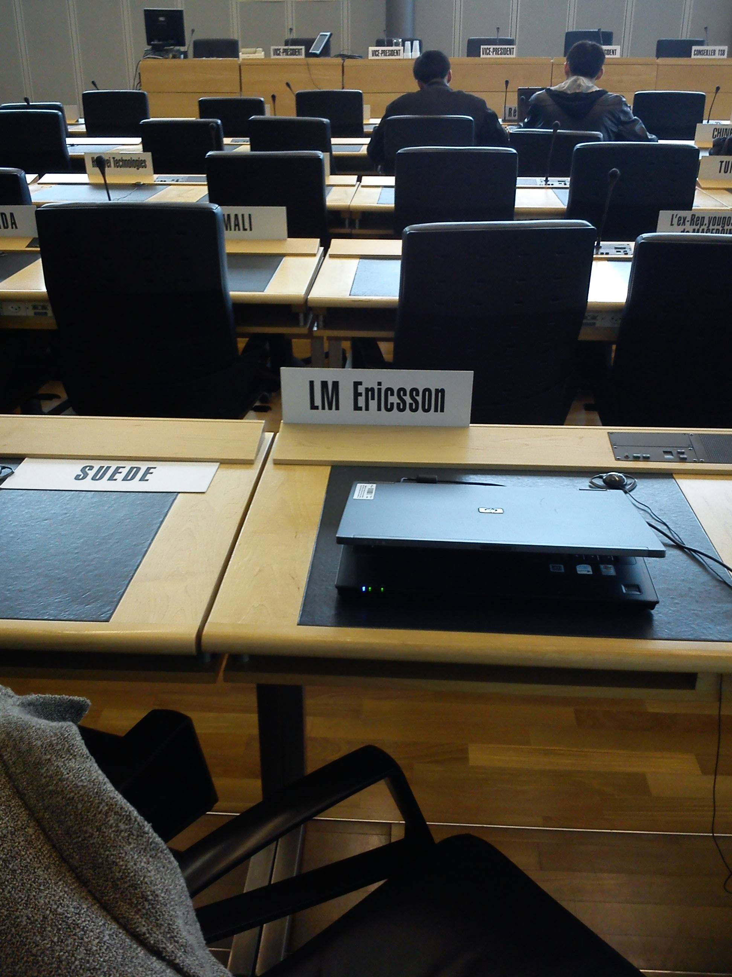
ITU headquarters, Geneva

Slide 4
QoE Assessment of eXtended Reality Meetings (P.QXM)
The P.QXM draft is hosted online:
https://docs.google.com/document/d/1p081ijmKBSDsmD-iYmOYlj6cWU9PqOJ93uoZivHY8aE/edit
All interested parties are invited to suggest edits and additional content that we can discuss during the monthly ITU-T SG12 Q7/Q10/Q13 calls and the bi-weekly P.QXM calls.
Planned to be ready for consent at the next ITU-T SG12 meeting in 7-17 June 2022.
Contribution deadline 25 May

Slide 5
Related work in other standardization bodies and industry
3rd Generation Partnership Project (3GPP)
Virtual Reality Industry Forum (VRIF)
Moving Picture Experts Group (MPEG)
MPEG-I: Coded Representation of Immersive Media, ISO/IEC 23090
ISO/IEC JTC 1/SC 29/AG 5 MPEG Visual Quality Assessment
Khronos Group
Video Quality Experts Group (VQEG)
European Network on Quality of Experience in Multimedia Systems and Services (Qualinet)
World Wide Web Consortium (W3C)
ITU-T SG16/Q8 Immersive Live Experiences

Slide 6
Factors influencing QoE of XR telemeetings
Human Influence Factors (HIFs)
Characteristics of the percepual and cognitive processes
Individual tendencies
Conversation behaviour
Relations between participants
Language and body language aspects
Context Influence Factors (CIFs)
Communication environment
Use case
Communication scenario
Time aspects
System Influence Factors (SIFs)
Human/world-related factors
Rendering
Network and compression

Slide 7
Constituents of QoE in XR telemeetings
A QoE Constituent is formed during an individual’s experience of a service.
Simulator sickness
Immersion
Presence, co-presence, and social presence
Plausibility
Ethics of XR use
Carving out mental space
Fatigue and cognitive load
Ability to reach goals

Slide 8
Test methods targeting XR telemeeting QoE constituents
Test paradigms
Conversation and behavior analysis
Post-experience questionnaires
Physiological measurements
Participants
Equipment

